Slide 1

ML project presentation
Giacomo Fantato ⋅ K-16958 ⋅ UW WNE 06/2025

Slide 2
Exploratory Data Analysis
EDA is performed on the training set for both classification and regression tasks

Slide 3
Data preparation
Clean missing data: remove rows with NaN values for consistency.
Reduce rare categories: group infrequent values (≤25) in categorical variables into “other".
Drop Low-Variance features: remove variables with little variation to reduce noise.
Encode categories: apply one-hot encoding to nominal features for model compatibility.
Visualize target: plot price_z and claim_status distribution to check class balance.
Save processed data: store both cleaned and encoded datasets for modeling in a pickle file.
NB: to create a dataset suitable for both regression and classification models, we do not remove non-informative columns (such as unit_id or src_month) at the beginning.
Instead, these columns will be dropped within each specific model pipeline, making the original dataset more flexible and reusable for various types of analysis.
Train set: 70/30 for regression, 60/40 for classification *
Make the predictions
Found best model for both task:
Train (5 or 10 folders)
Validation
Test
*‘random_state=42’ for reproducibility on CV folder split on the regression | ‘random_state=123’ for the CV stratified - classification

Slide 4
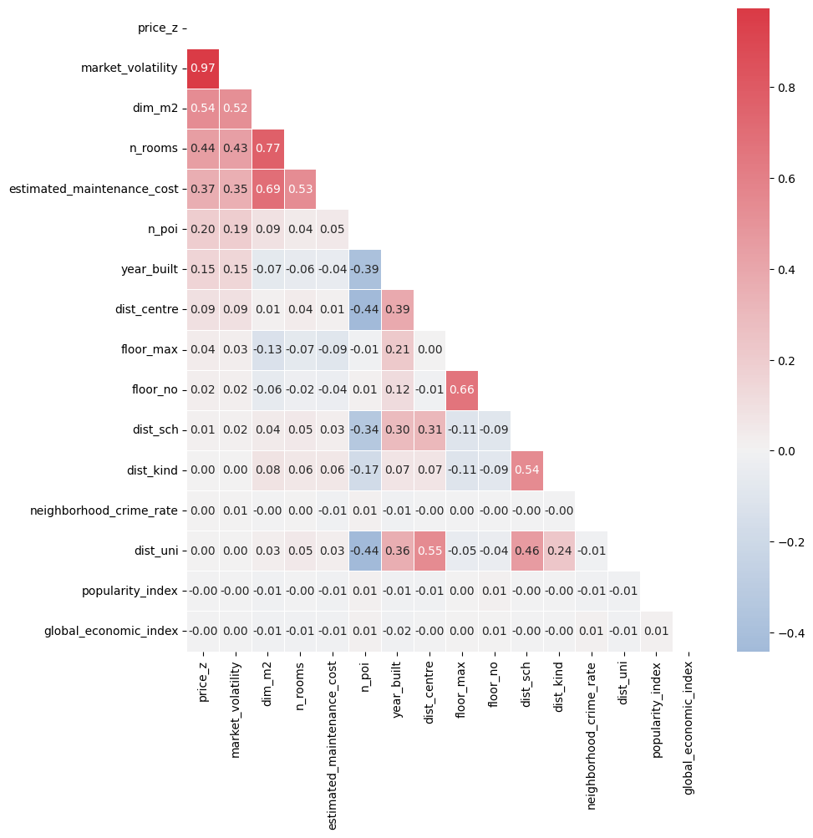
Data exploration - regression
Now let's look at the behavior of the variables in the regression dataset – quantitative explanatory vars
Strong correlation with price: market volatility shows a very high positive correlation with the target (key predictive variable). Dim_m2, n_rooms, and estimated_maintenance_cost also show moderate to strong correlations, suggesting relevance.
Multicollinearity warning: high inter-correlation between dim_m2 and n_rooms, and between floor_no and floor_max, may require attention during feature selection or model regularization.
Negative correlations: year_built and distance to center show negative relationships with price_z, indicating newer or centrally located apartments might be valued higher.

Slide 5
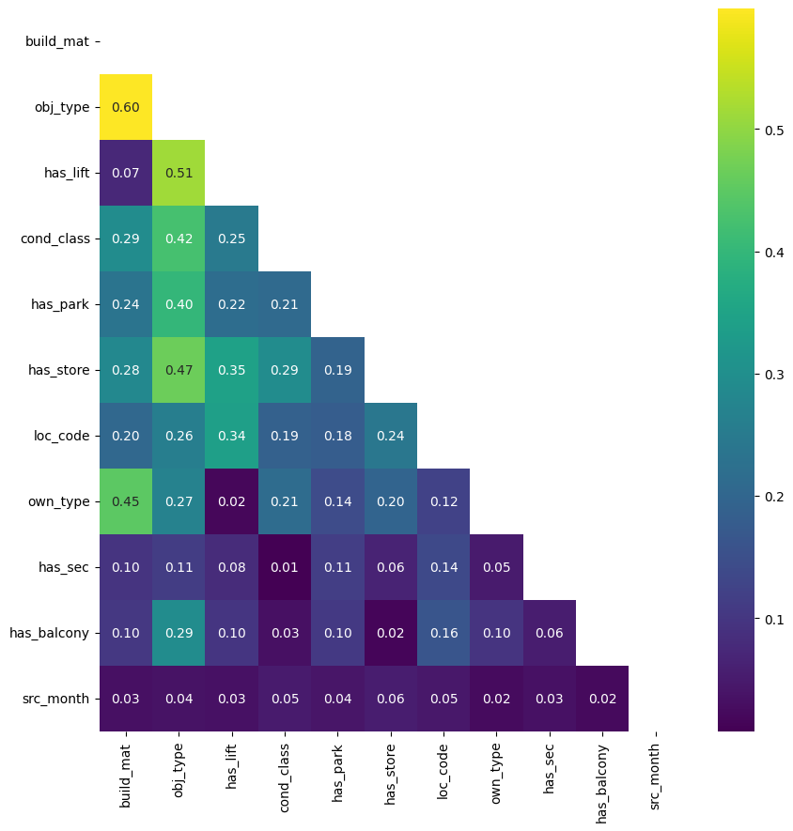
Data exploration - regression
Now let's look at the behavior of the variables in the regression dataset – qualitative explanatory vars
Moderate correlations: obj_type and build_mat show a notable correlation (0.60), suggesting object type may influence construction materials used. Has_lift, cond_class, and has_store also correlate moderately with several features, indicating they may capture relevant structural or amenity information.
Related amenities: moderate associations between has_lift, has_park, and cond_class suggest that better-conditioned or higher-quality properties are more likely to include amenities.

Slide 6
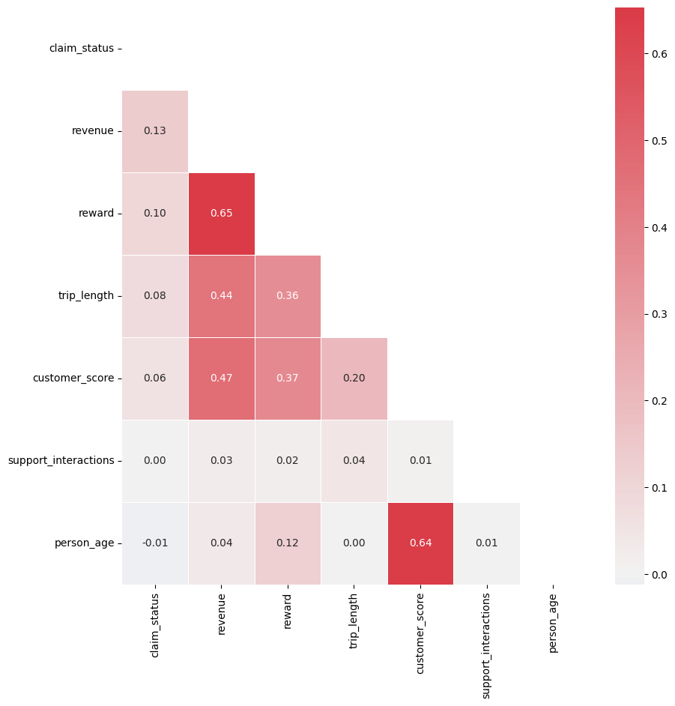
Data exploration - classification
Now let's look at the behavior of the variables in the regression dataset – quantitative explanatory vars
No strong correlation found between individual features and claim_status (highest: revenue = 0.13).
Moderate correlations observed among features:
Reward and Revenue (0.65) → it suggest that higher premiums are associated with higher revenues.
Customer_Score and Reward (0.47)
Customer_Score and Person_Age (0.64) → suggest that clients with higher scores tend to be older and receive higher rewards.
Moderate correlations between some independent variables (reward, revenue, customer_score, and person_age) suggest potential multicollinearity.

Slide 7
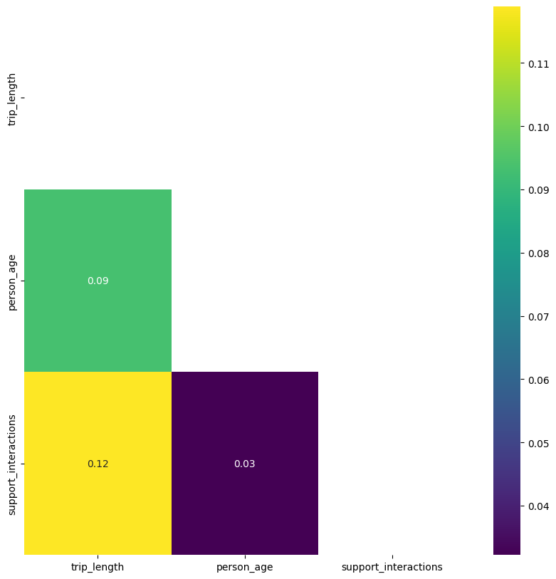
Data exploration - classification
Now let's look at the behavior of the variables in the regression dataset – qualitative explanatory vars
Weak correlations across all variable pairs.
Slight positive link between trip_length and support_interactions (0.12).
Very low correlation between person_age and other variables. That means there’s no strong linear relationships detected; these features are largely independent.

Slide 8
Regression task
Overview of regression techniques used

Slide 9
Ridge, LASSO, Elastic Net – best model
Elastic Net is the first-best performing model found. The best parameters found due to the pipelining are:
'model__alpha': 0.00046415888336127773, 'model__l1_ratio': 0.3, 'select__k': 'all’
with 5 folds for each of 200 candidates, total 1000 fits.
Test set (mean CV):
RMSE: 101953.8414 | MAE: 75167.8712 | MedAE: 58191.1299 | R²: 0.9532
Validation set:
RMSE: 101838.4489 | MAE: 75315.6437 | MedAE: 57549.2436 | R2: 0.9534
It showed excellent generalization, with validation RMSE nearly matching CV RMSE. A low alpha and
moderate l1_ratio (0.7) yielded the best results, balancing L1 and L2 regularization. In addiction the RMSE
% (RMSE as percentage of mean z-price) is 12.39%
The high R² (0.95) and low MAPE (9.32%) indicate strong predictive performance, confirming ElasticNet
as a reliable and interpretable alternative to SVR. The model does not overfit, as shown by minimal RMSE
gaps: 0.22% (Train vs Val) and 0.11% (CV vs Val).
'unit_id' and 'src_month' were excluded due to their lack of predictive relevance.

Slide 10
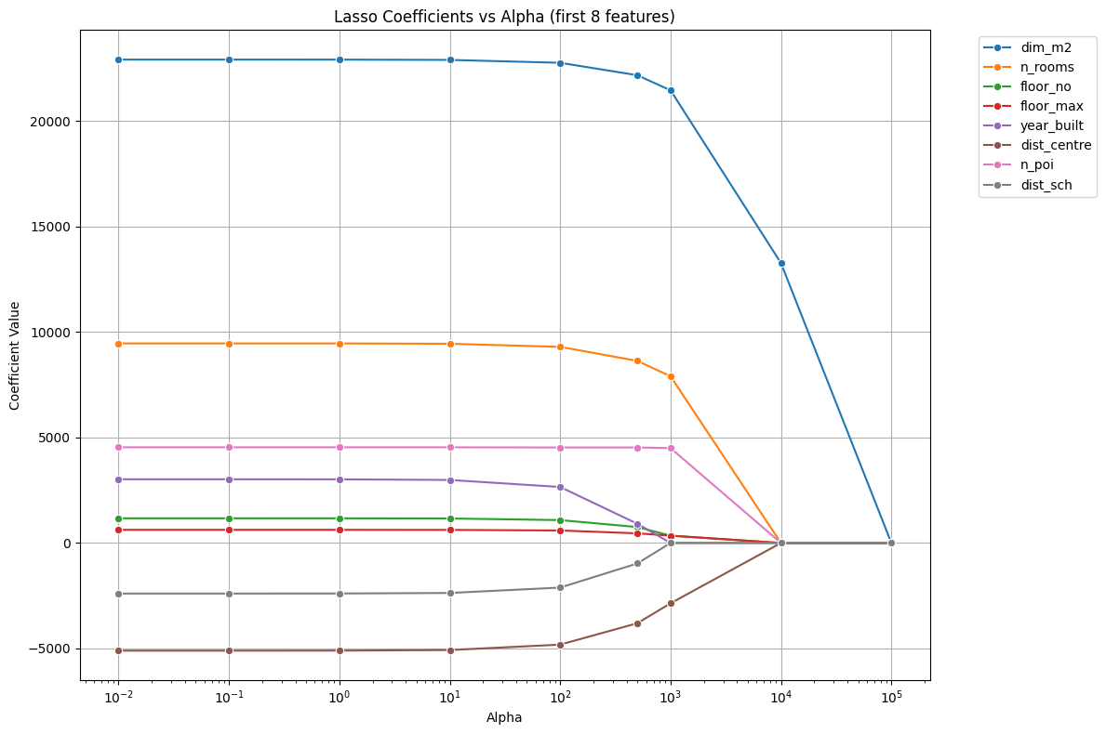
Ridge, LASSO, Elastic Net – best model
LASSO coefficient analysis reveals that dim_m2 and n_rooms consistently have the largest and most stable coefficients, indicating they are strong and robust predictors of the target variable.
Features like dist_centre, dist_sch, and others are shrunk to zero when alpha is large. These may be less info or redundant.
Computaional costs (L1): O(K²n) if K < n, O(k³) if K ⩾ n; better SVR*.
* Least Squares Optimization with L1-Norm Regularization, Mark Schmidt, CS542B, Project Report, December 2005

Slide 11
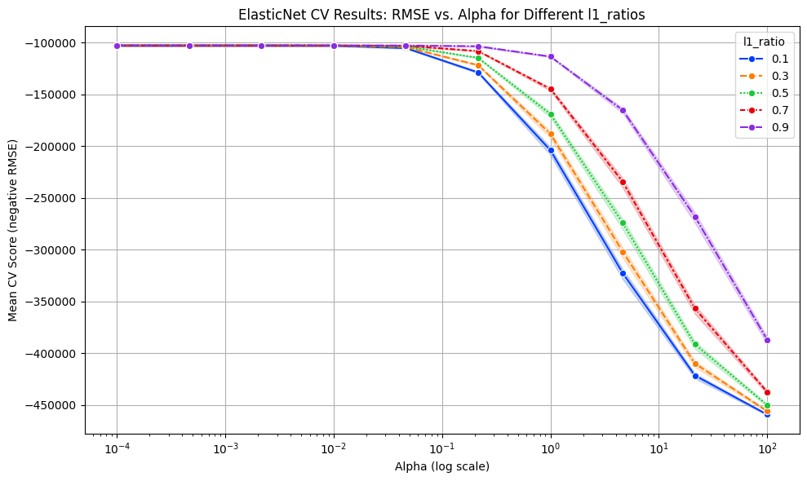
Ridge, LASSO, Elastic Net – best model
Elastic Net analysis: ElasticNet performance is optimal at low alpha values across all l1_ratios.
Models with stronger L1 regularization (l1_ratio between 0.7 - 0.9) slightly outperform others, suggesting that promoting sparsity is beneficial, as long as the regularization strength remains moderate.
Computational costs: O(AK²n) |
O(Ak³), where A is the grid size for
tuning the parameters, that
balances the weights of ridge
versus LASSO; SVR still better in
performance.

Slide 12
SVR – second model
After evaluating 45 combinations of hyperparameters using GridSearchCV with 10-fold cross-validation (10 folds for each of 45 candidates, 225 total fits), the SVR model with linear kernel emerged as the second-best performing model. Optimal parameters found:
'model__C': 100 | 'model__gamma': 0.001 | 'model__kernel': 'linear'
It achieved the second-lowest average RMSE across all tested models, demonstrating solid predictive accuracy and consistent performance on both training and validation sets. The model also proved to be stable and generalized well to unseen data.
Avg CV RMSE: 131.483 (+22.5%)
Avg CV R² : 0.9220 (-3.4%)
Validation RMSE 130,084 (+21.6%)
Validation R² 0.9239 (-3.2%)
Although the ElasticNet model had slightly better overall performance in terms of RMSE and R², the SVR model was a close second, and still represents an excellent option due to its robustness and minimal overfitting.

Slide 13
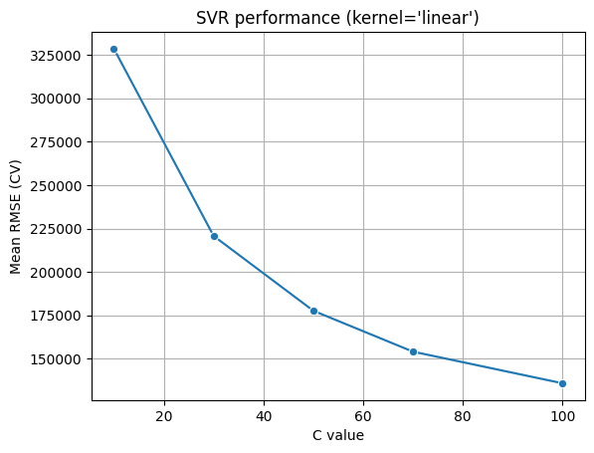
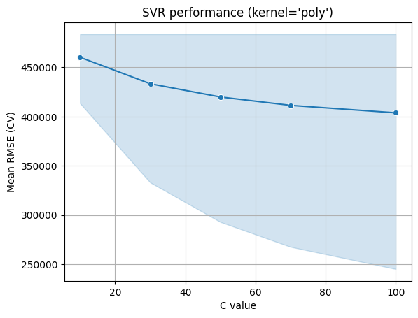
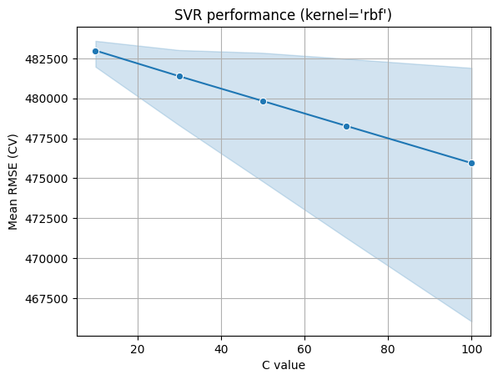
SVR – second model
Best performance
RMSE drops sharply as C increases
Poor performance
even at high C, RMSE remain > 200K$
High RMSE
~ 475K$ across all C values
Hyper parameters optimization: a full scikit-learn pipeline was applied for consistent preprocessing and model training. GridSearchCV with 10-fold cross-validation was used to test 45 hyperparameter combinations (in total 450 model fits).
The best parameters are: C = 100 | gamma = 0.001 | kernel = 'linear’.

Slide 14
SVR – second model
Introducing an SVR model based on the best-performing configuration, and including engineered interaction features (combined and/or individual), did not lead to improvements (it resulted in significant performance degradation).
The added features either do not contain additional predictive patterns or introduce noise into the model.
m2_per_room: living space per room (spatial efficiency) → X['dim_m2'] / (X['n_rooms’])
cost_per_m2: maintenance cost per square meter → X['estimated_maintenance_cost'] / X['dim_m2']
green_dist_ratio: green space access relative to distance from city center → X['green_space_ratio'] / X['dist_centre’]
Applying a log_transformation did not improve performance (target distribution is not skewed enough).
No signs of underfitting or overfitting: the model does not overfit the training data nor underfit the problem. The performance on the validation set is in line with or better than cross-validation results, suggesting good generalization (less than 10% error).
Computational cost: O(n³) for the training | O(sv × features) for the predictions

Slide 15
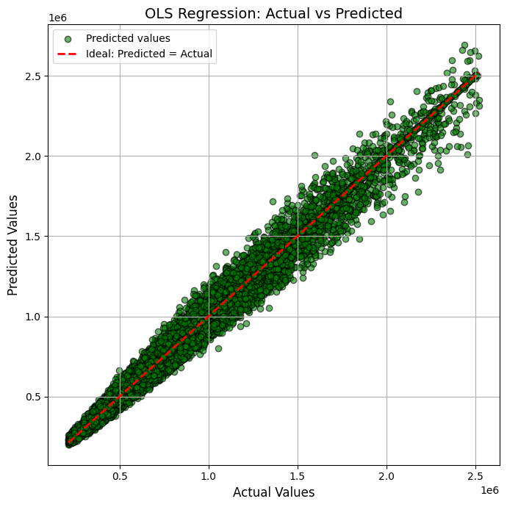
OLS – worst case scenario
The predicted values are generally aligned along the ideal line, suggesting that the model captures some linear relationship between the variables.
However, there is increasing dispersion at higher value ranges, indicating that the model loses precision as the target values grow.
The presence of systematic deviations suggests that the linear regression model fails to capture the full complexity of the dataset, likely due to non-linear relationships or unmodeled interactions.
Mean RMSE: 132442.82
The variability across folds is also notable, indicating some instability in the model's performance. Moreover, the average RMSE is the highest recorded among all tested models.

Slide 16
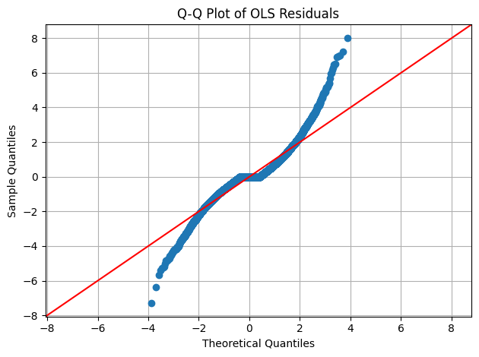
OLS – worst case scenario
The residuals are not normally distributed, which undermines the reliability of estimates such as confidence intervals and significance tests in OLS models.
This further supports the idea that linear regression is not well suited for this dataset and that more flexible, non-linear models may provide a better fit.
Computational cost: O(n²d + d³), n = # of samples, d = # of features; d³ = inverted matrix.

Slide 17
Classification task
Classification models applied to predict the claim outcomes

Slide 18
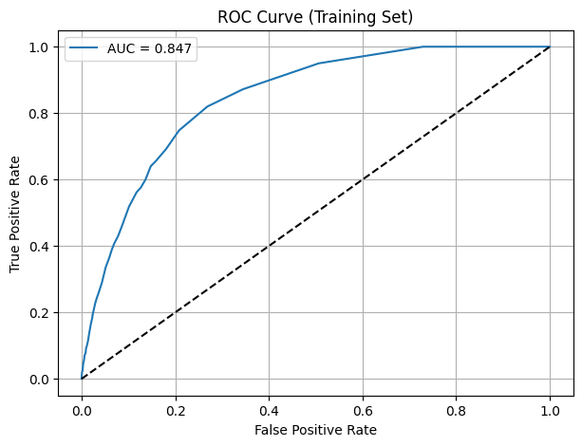
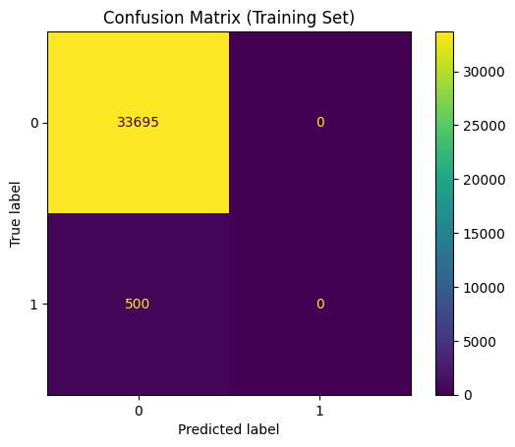
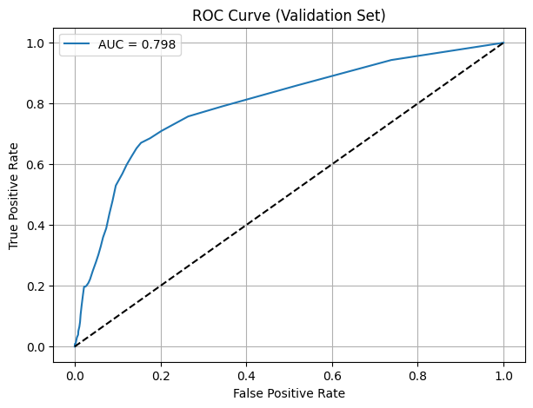
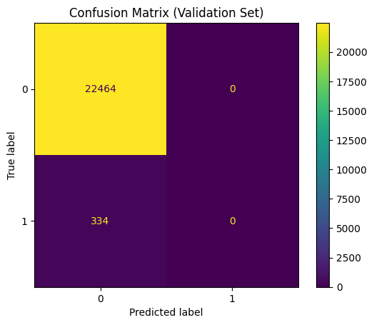
KNN – worst case scenario
Best model hyperparameters: K = 279 | weights = uniform
An initial approach involved the use of a K-Nearest Neighbors (KNN) model, despite the presence of a significant class imbalance in the dataset.
The data is heavily skewed, which is reflected in the confusion matrix above. It’s noticeable that during validation, each fold yields a different AUC, while the balanced accuracy consistently remains at 0.5000.
Since KNN does not handle imbalanced classes effectively, switching to an algorithm that supports the class_weight='balanced' parameter is recommended to better account for this issue.

Slide 19
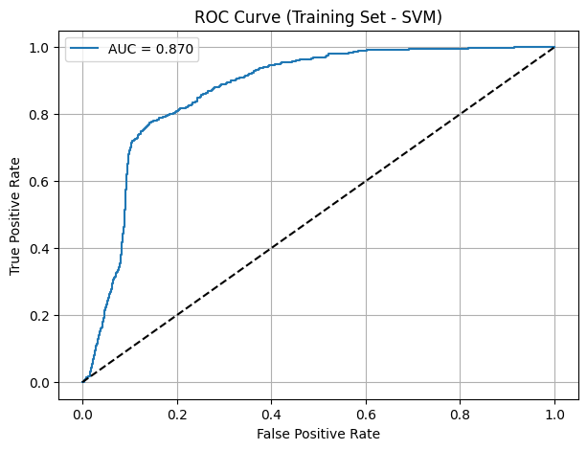
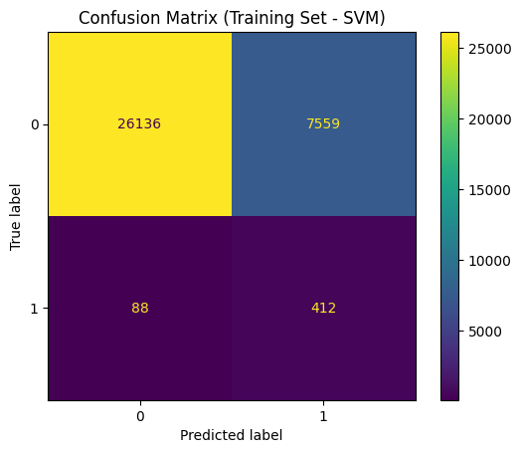
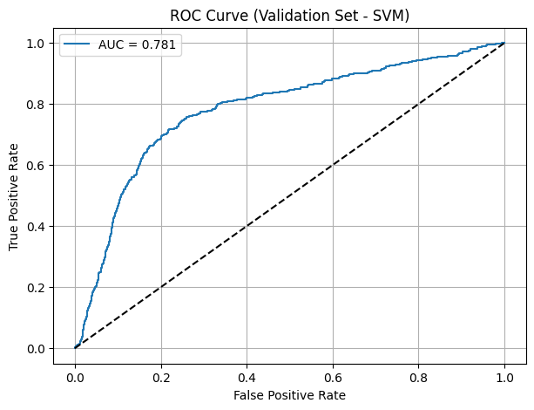
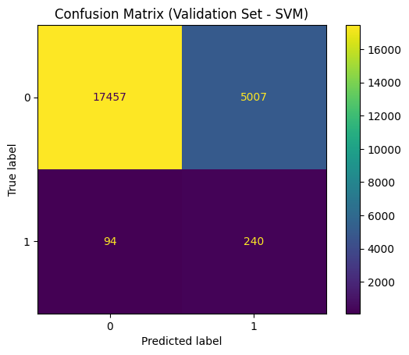
SVM – second best model
Best model SVM parameters: Kernel: rbf | C: 1.0 | Gamma: scale | Class Weight: balanced | Probability: True
Cross validation performance (5 folds):
Avg ROC AUC: 0.7719
Avg Balanced Accuracy: 0.7320
Stable performance across folds with noticeable variation in AUC.
Very high precision for class 0 (1.00), but low for class 1 (0.05) → class imbalance is evident.
Validation set:
ROC AUC: 0.7810
Balanced Accuracy: 0.7478
Similar trends as training: strong performance on majority class, but weak precision on minority class
NB: same computational costs of SVR in time and resources
The columns agent_id_*** and entity_a_*** were dropped because they increase the risk of overfitting, especially with linear models like logistic regression. Additionally, they introduce sparse features with limited generalizable predictive power.

Slide 20
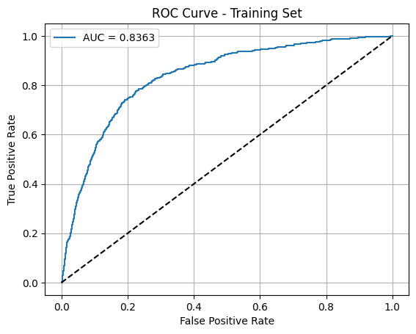
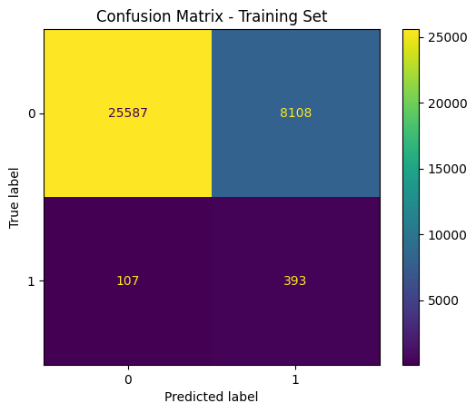
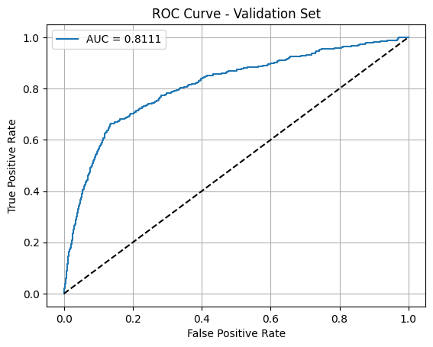

Logistic regression – best model
Best model parameters: 'logreg__C’: 1 | 'logreg__penalty': 'l2’ | 'logreg__solver': 'liblinear'
This is the best model so far because it achieves higher overall performance compared to the previous one.
It shows improved average ROC AUC (0.8363 vs. 0.7719) and balanced accuracy (0.7727 vs. 0.7320) across cross-validation folds. Additionally, it performs better on the validation set with a ROC AUC of 0.8111 and balanced accuracy of 0.7466 indicating better handling of the class imbalance.
The ROC curves and confusion matrices show that this model and the SVM perform very similarly, with this model offering a slight improvement.
Computational costs: O(nd) for the training | O(d) for predictions, n = # samples, d = # features ^{(source)}

Slide 21
Predictions
Performed only on the best classification and regression models at the end, to avoid data leakage

Slide 22
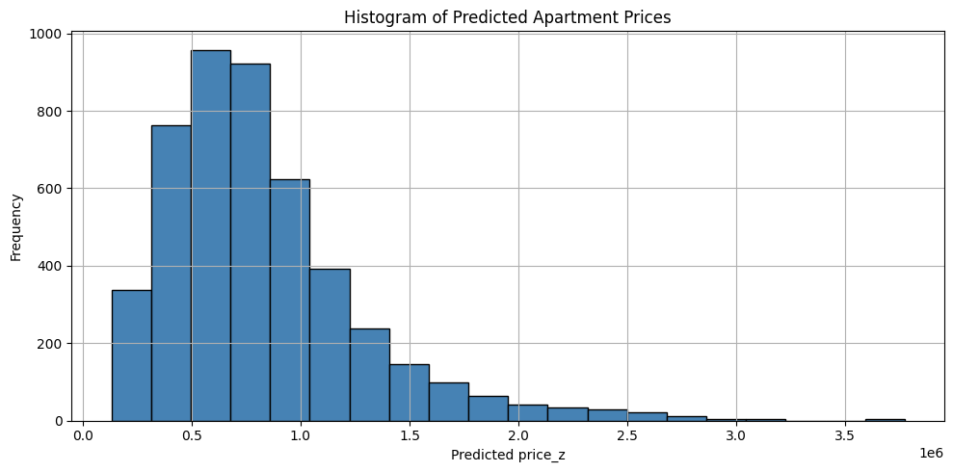
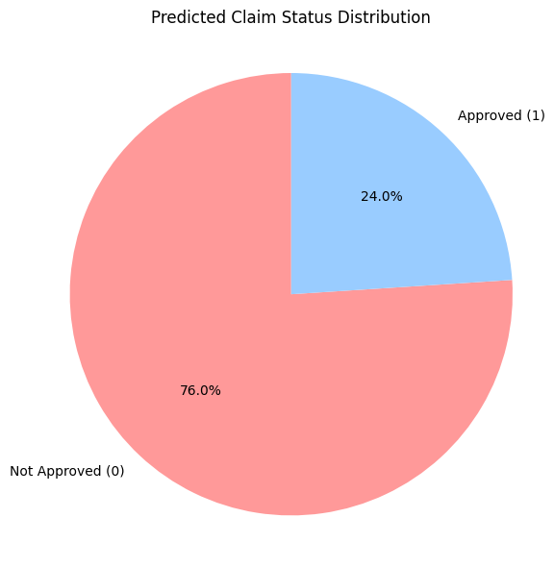
Elastic Net and LR forecast distribution
Elastic net
Logistic Regression
Distribution of apartment prices, highlighting the most frequent price ranges.
The distribution of predicted classes (0 and 1) is as follows on Test Set: 24% for 1 - 76% for 0 class.
Test set analyses are unreliable since the construction and sampling methods of the test sets are unknown.

Slide 23
Technical choices and conclusion
Let's look at the technical choices made and the conclusions

Slide 24
Software engineering – UML diagram
Data pipeline
SW dev.
Go live
DataFilter
Model
Predictions
i.e. DataClassification.py
i.e LR.ipynb
i.e. class_ped.csv
FeatureSelection
Validation and test
Output model
i.e. featureSelection.ipynb
i.e. LR_model.pkl
Predict

Slide 25
Cloud computing – HPC
Each machine learning experiment was structured into modular, class-based components, separating:
Model logic (e.g., training, validation, evaluation)
Data loading and preprocessing
This decoupled architecture ensured high flexibility, reusability, and clean integration across different experiments (e.g., ElasticNet, Logistic Regression).
Execution was significantly accelerated using HPC resources on Cineca’s Leonardo Boost Cluster, exploiting:
1× 32-core Intel Xeon Platinum 8358 CPU (2.6 GHz), 512 GB DDR4 RAM, 4× NVIDIA A100 (used 1) 64 GB GPUs, and 2× dual-port HDR (400 Gbps) interconnect.
Parallelized K-Fold cross-validation
This reduced average training time from ~160 minutes (Intel Core i7, 10th gen laptop) to just ~2 minutes on the HPC cluster, enabling rapid experimentation and scalable model evaluation, using CUDA acceleration.
Writing the projects as Python classes enabled fast deployment on the HPC platform, where commands are executed via shell (SLURM) and files are uploaded through FTP. This structure made the code easy to load and run efficiently on Cineca’s system.

Slide 26
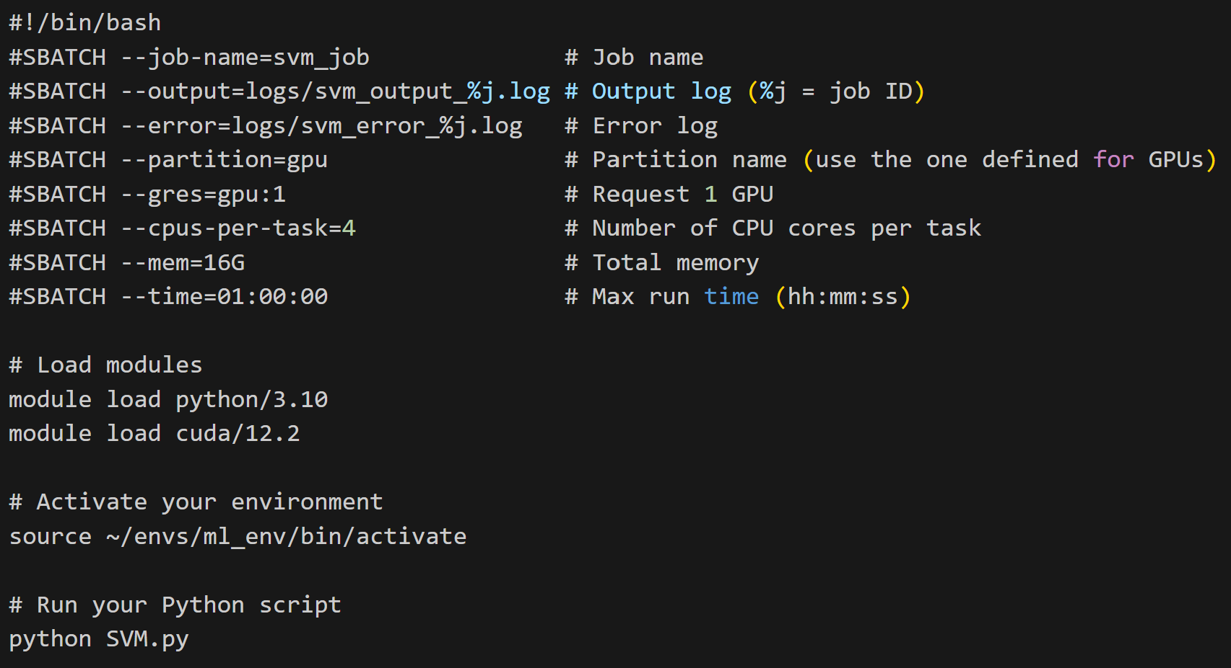
Cloud computing – HPC
Example of model execution on HPC Leonardo using a SLURM batch script for SVM training
sbatch svm_job.sh

Slide 27
Thanks!
Do you have any questions?
g.fantato@student.uw.edu.pl
GitHub Project link

